Slide 1
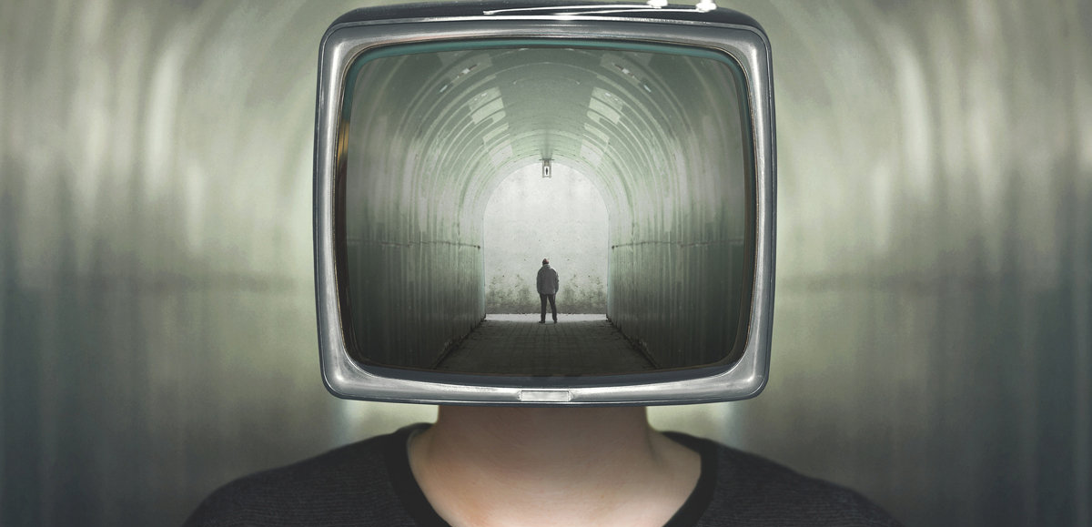
DEEPFAKES
The inevitable problems and advancements of
CTI 120 | Aelous Zid Julian

Slide 2

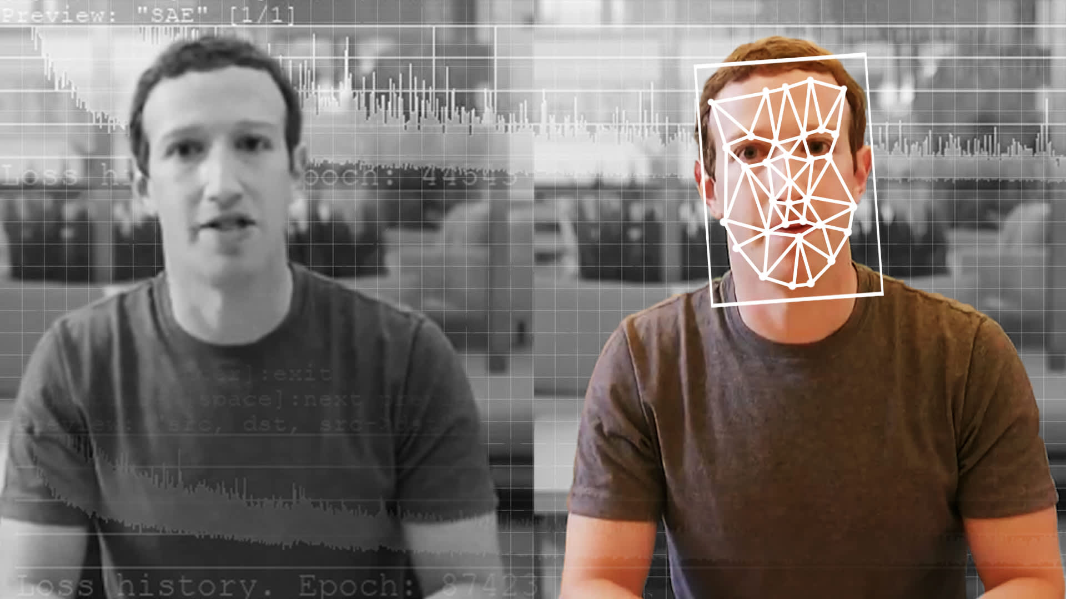
WHAT ARE DEEPFAKES?

Slide 3
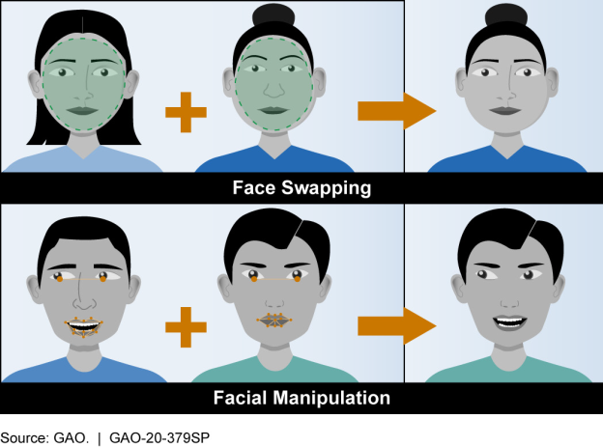
DEEPFAKES
A video, photo, or audio recording that has been artificially (AI) manipulated to appear real.
The technology can…
Replace faces
Manipulate facial expressions
Engineer false face and speech
HOW DOES IT WORK IN RELATION TO NETWORKING?
Using artificial neural networks that recognize patterns in data, videos, photos, or voice recordings are reconstructed to resemble something else.
(AI Generated Synthetic media)

Slide 4
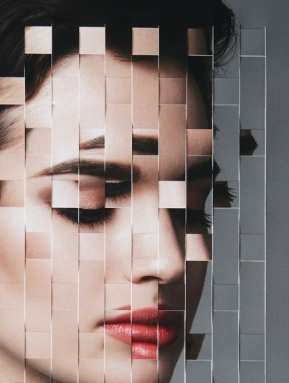
IT’s IMPORTANCE
ADVANCES IN:
Accessibility
Helps those who are visually impaired, suffering from speech impediments, or diseases like Amyotrophic Lateral Sclerosis
Education
Innovative lessons: such as bringing historical figures back to life
Showcase synthetic human anatomy
Film Production
CGI, VFX, SFX
Criminal Forensics
Reconstruct crime scenes
Artistic Expression
Graphics and imagery

Slide 5
PRESENT SITUATION
Primarily, DEEPFAKES are currently used by amateur enthusiast, VFX studios, and porn producers.
+ Government interest shows that the technology is being explored as a strategy to contact groups or targeted individuals.
CURRENT ISSUES
Have been used for scamming
Realistic fake videos could cause political and societal crisis
- Such as the use of DEEPFAKES to create videos of Trump saying eerie messages
Tarnish reputations
- DEEPFAKES have been used to create pornographic videos of celebrities

Slide 6
POSSIBLE FUTURES
POSSIBLE CHANGES THAT ARE LIKELY:
Easier access to the technology
Currently, believable DEEPFAKES are produced by high-end computers. More than likely, as we advance in technological feats, accessibility to the technology will be more available to the mass
Although, with more accessibility comes more vulnerability for the technology to be abused
Stricter regulations and laws
- More access to the technology means more likelihood for the need to ensure that the use of it would not be detrimental
Advancements in network and security
- Facial recognition technology embedded within DEEPFAKES can allow an advancement in security as it will help recognize targeted individuals reviewed in recordings.
Advancements in society
- Education, forensics, artistic expressions, and more.

Slide 7
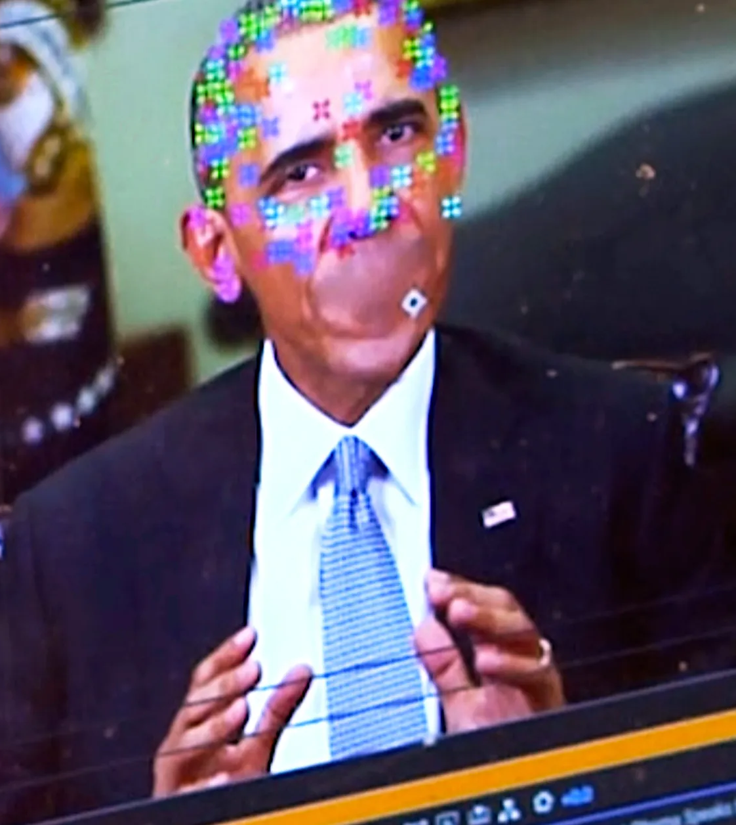
POSSIBLE CHANGES THAT ARE UNLIKELY:
Full regulation and control on the content produced
- To regulate the misuse and abuse of this technology is next to impossible
- Control on individuals creating content that harms the reputation of people (such as creating pornographic videos of celebrities) or content that causes political disarray is always likely with this technology

Slide 8
FUTURE FORECAST
WHEN COULD THESE CHANGES OCCUR?
These changes are already occurring… and soon, developments on the technology should make it more easily used by everyone.
+ DEEPFAKES are continuously developed to be more accessible.
+ A Chinese app called Zao introduced DEEPFAKES to Chinese society. It allows one to make DEEPFAKE videos within seconds.
+ As DEEPFAKES get more popularized and developed, so will its uses in the potential personal, medical, and educational means.
+ Research on the uses of DEEPFAKES are supported by the government with laws passed like the Identifying Outputs of Generative Adversarial Networks (IOGAN) Act
Laws on the uses of DEEPFAKES are an utmost important…
National Defense Authorization Act for Fiscal Year 2020 notes the much-needed research and concern on the weaponization of DEEPFAKES.

Slide 9
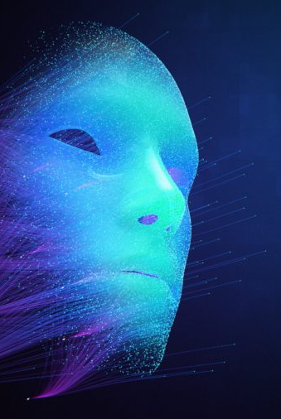
IT’S EFFECT
With research and well-developed ideas around DEEPFAKES, this will affect:
Education and the way we learn
The medical field and how simulations can be used to help those who are impaired
- Such as those who lost their voice
Society in the appropriate use of DEEPFAKES that allows self expression without disregarding the well being of others
Laws that deal with foreign and local weaponization of the technology
Network and security, specifically AI and it’s uses
- This development could lead to either a more secured network that can detect harm and dangers, or a weapon that can easily endanger the safety of people

Slide 10
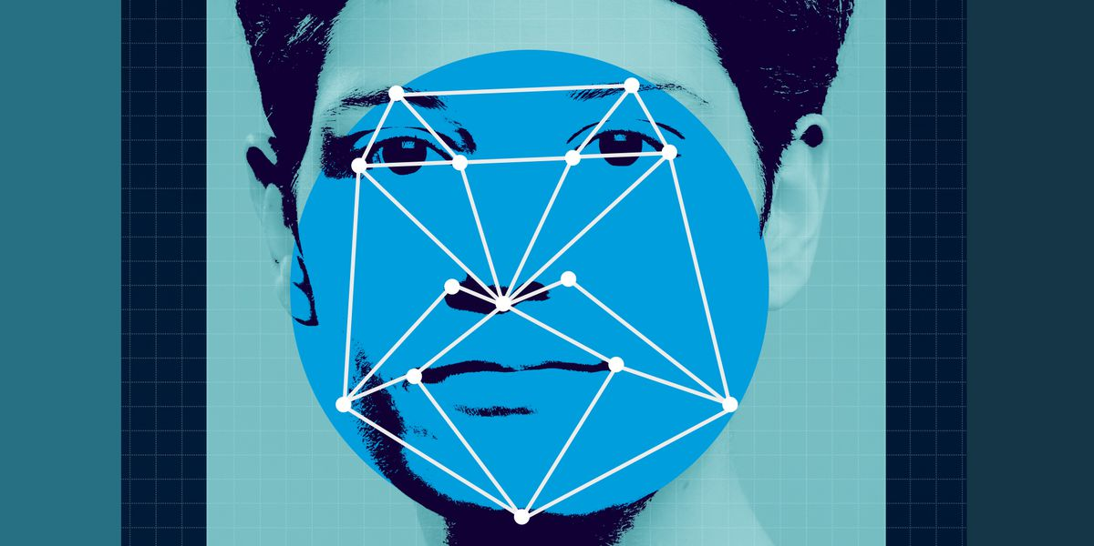
OPINION
DEEPFAKES technology is both a positive and negative
I’m confident that with proper use, DEEPFAKES can lead to numerous advancements in various fields
The ongoing trajectory of how it’s being developed and made accessible to more people will pressure more stricter regulation on the technology
Although, I’m also very confident that with its development and easy access will come abuse of the technology and our inevitable inability to fully protect the negative impact of such technology

Slide 11
Works cited
Jaiman, Ashish. Positive Use Cases of Deepfakes. 14 August 2020. 5 March 2021.
Owen-Jackson, Charles. What does the rise of deepfakes mean for the future of cybersecurity? 2019. 5 March 2021.
Porup, J.M. How and why deepfake videos work — and what is at risk. 10 April 2019. 5 February 2021.
Sample, Ian. What are deepfakes – and how can you spot them? 13 January 2020. 5 March 2021.
SPRINGWISE. PROS AND CONS: DEEPFAKE TECHNOLOGY AND AI AVATARS. 9 October 2020. 5 March 2021.
Staff, Beebom. 8 Best Deepfake Apps and Websites You Can Try for Fun. 29 December 2020. 5 March 2021.
Wilmerhale. First Federal Legislation on Deepfakes Signed Into Law. 24 December 2019. 5 March 2021.

